Slide 1
Quantitative Methods Lecture-8

Slide 2
Survey Errors and Sampling Distributions
(Ch 1 & Ch 7 Business Statistics, Levine et al.)

Slide 3
So far and the next
Previous Sessions
Discreet Probability Distributions
Probability mass function (PMF) and Cumulative probability distribution
Continuous and Normal Distributions
Probability Density Function (PDF) and Cumulative Distribution Function (CDF)
Probabilities as area under the PDF curve (region of interest).
Use of cumulative Z tables to calculate normal probabilities
One sided Z table (+Ve or –Ve values) is sufficient as the distribution is symmetric
Today
Survey errors
Sampling distributions

Slide 4
Setting the context for the next few sessions
You want to understand characteristics of the population
Proportion of votes party-A will get (exit polls)
Mean fill volume in a bottle of your coconut-water brand
Proportion of the market segment that prefers your brand
However, practically, you can only work with small samples
You would need to make inferences about the population from the sample data
Core concept is probability distribution and
Calculating probabilities of a Random Var. lying between certain range
In the prv. Session, we learned that in detail for a normally distributed random variable

Slide 5
Surveys and Survey Errors
(Ch 1 Business Statistics, Levine et al.)

Slide 6
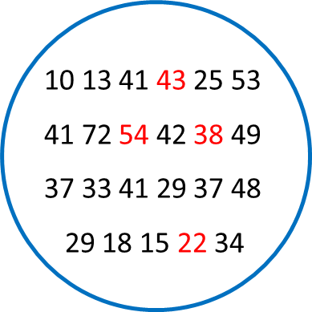

Census and Sampling
Census
Entire population (population, tiger, agriculture, health facilities).
Sampling
A portion of the population.
Quality, voting, blood, soil, customer surveys, voice, interviews, ….
Why samples?
Quicker.
Cheaper.
May not participate/Not available.
When tests are destructive.
Scientifically chosen samples can give very good accuracy about the properties of the population.
43, 54, 38, 22
Population Sample
N, N, Y, N Y, N, Y, Y

Slide 7

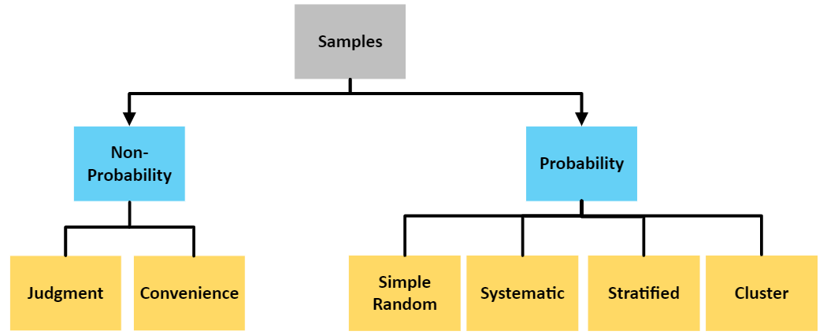
Sampling methods

Slide 8
Objective of the sampling
Main objective
Estimating properties of the population
Sample properties are a way to estimate the parameters of the population
Mean
What is the mean life of a battery from brand-A?
Proportions
What proportion of the population prefers my product over the competitor’s?
Only a sample drawn by probability sampling can be used for estimating population parameters

Slide 9
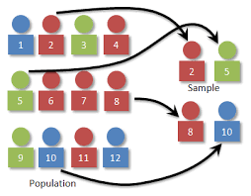
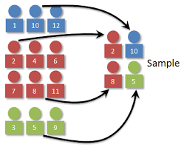
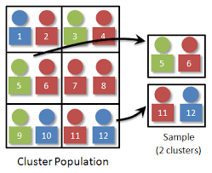
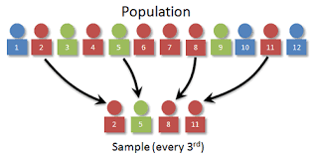
Probability sampling
Simple random sampling
p=1/12 from population
Stratified sampling
Proportional to strata
stratum is homogeneous
Cluster sampling
heterogeneous cluster
Systematic sampling
Every nth item/bottle

Slide 10
Survey errors
Coverage error
A portion of the population is excluded from the sampling frame
Nonresponse error
Some from the chosen sample may not respond
Measurement error
Approximate scales
Psychological scales give approximate values
Attitudes, strength of beliefs etc.
Bad or leading question
Do you like color and taste of the candy?
Yes / No
Sampling error
You get a different sample each time you draw a sample
Sample to sample random differences

Slide 11
Sampling Distributions
(Ch 7 Business Statistics, Levine et al.)

Slide 12
Sampling Distributions
Sampling Distributions
Sampling Distribution of the Mean
Sampling Distribution of the Proportion
Population: Normally Distributed
Population: Not Normally Distributed

Slide 13
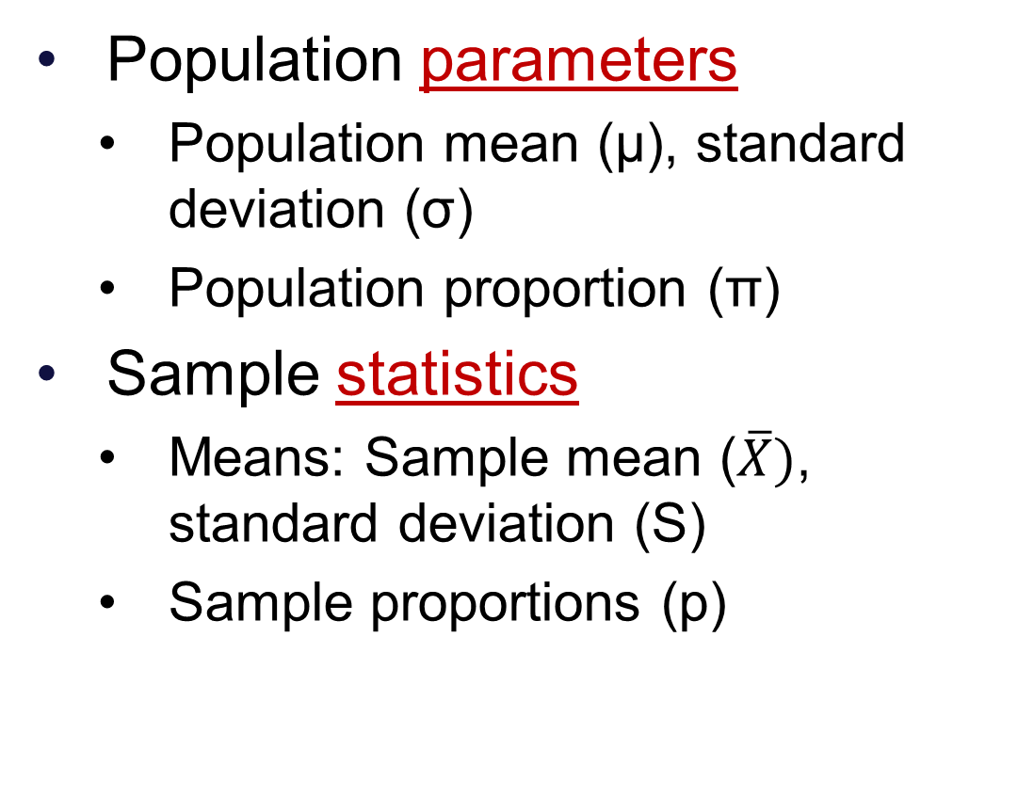
Population parameter(s) and Sample statistic(s)
Population parameters
Population mean (μ), standard deviation (σ)
Population proportion (π)
Sample statistics
Means: Sample mean ($\overline{X})$, standard deviation (S)
Sample proportions (p)

Slide 14
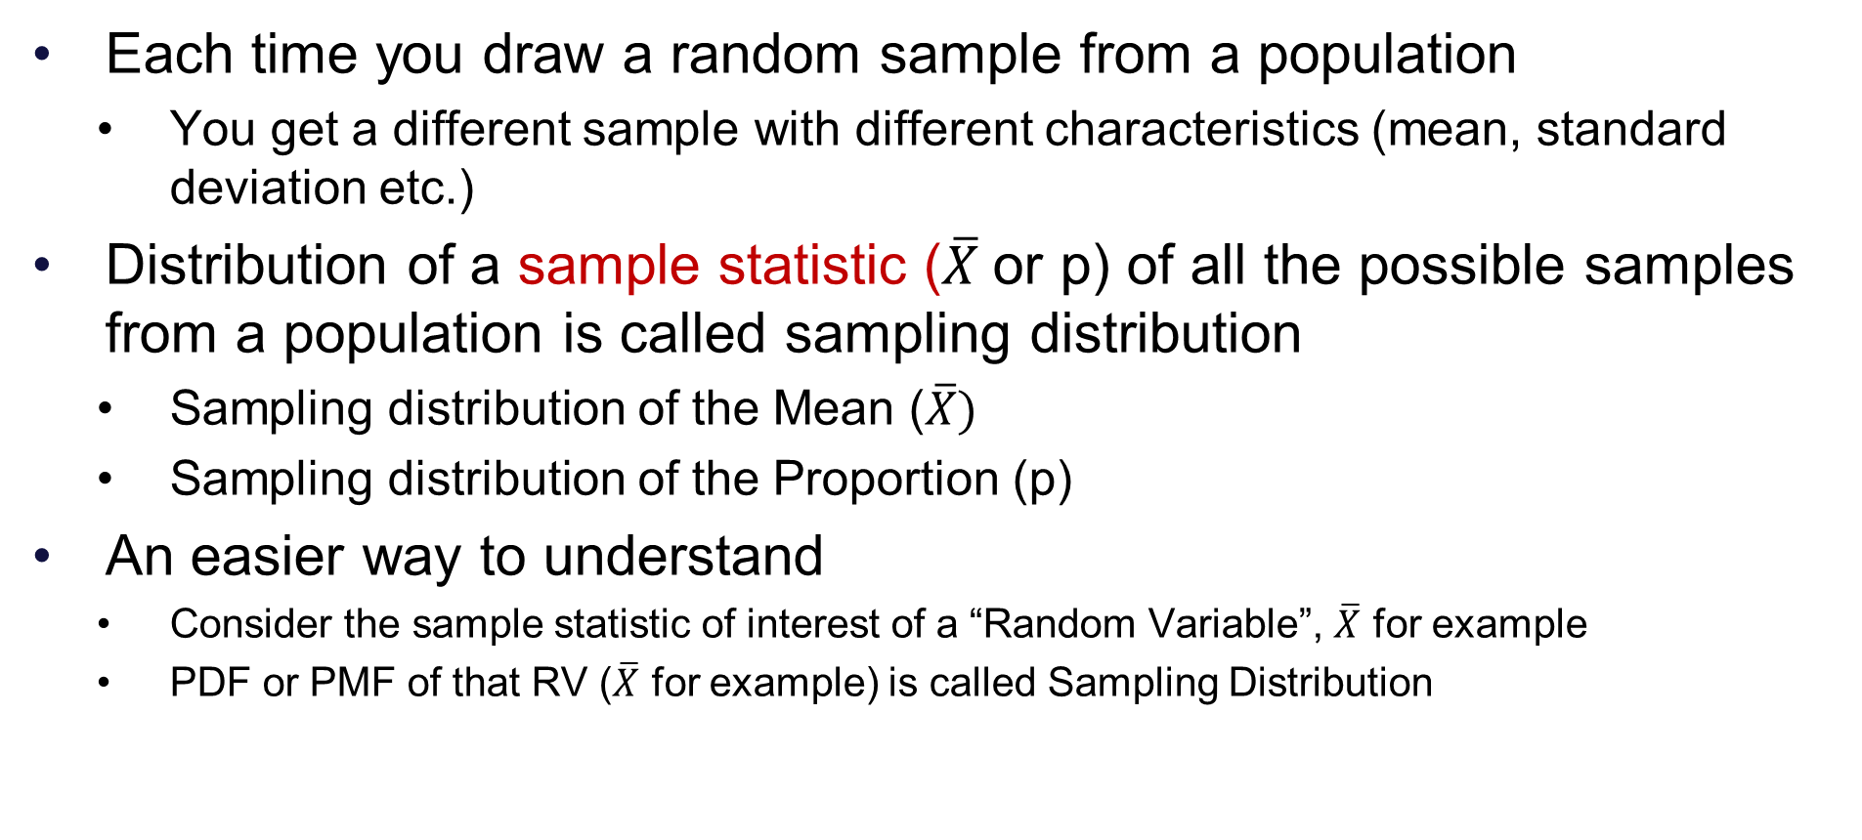
Population >> Samples >> Sampling Distribution
Each time you draw a random sample from a population
You get a different sample with different characteristics (mean, standard deviation etc.)
Distribution of a sample statistic ($\overline{X}$or p) of all the possible samples from a population is called sampling distribution
Sampling distribution of the Mean ($\overline{X})$
Sampling distribution of the Proportion (p)
An easier way to understand
Consider the sample statistic of interest of a “Random Variable”, $\overline{X}$ for example
PDF or PMF of that RV ($\overline{X}$ for example) is called Sampling Distribution

Slide 15
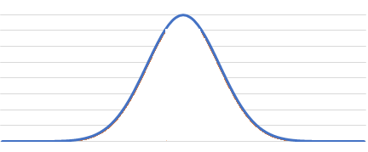

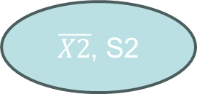
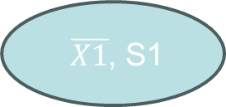
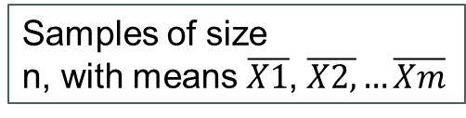

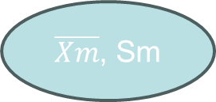
Population >> Samples >> Sampling Distribution
$\overline{X1}$, S1
X ~ N(µ,σ²)
$\overline{X}$ ~ N(µ,$σ_{\overline{X}}$²)
$\overline{X2}$, S2
X values
(Age, height, weight etc.)
$\overline{X}$ values
$\overline{Xm}$, Sm
Samples of size
n, with means $\overline{X1}$, $\overline{X2,}…\overline{Xm}$
Sampling Distribution of the Mean
Population: Random variable X

Slide 16

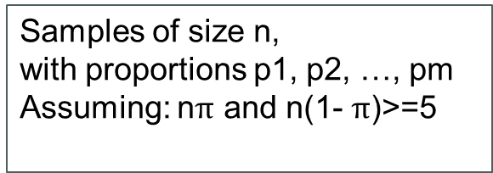

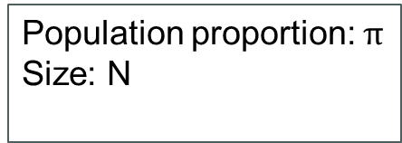
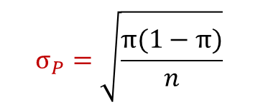
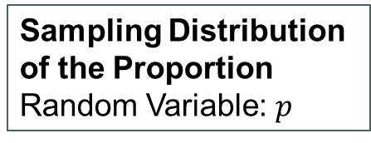
Population >> Samples >> Sampling Distribution
p1
Mean $= π$
$$σ_{P}=\sqrt{\frac{π(1−π)}{n}}$$
Population proportion: $π$
Size: N
p2
Proportion females, supporting candidate-A, products containing faults etc.
pm
$$p$$
Samples of size n,
with proportions p1, p2, …, pm
Assuming: n$π$ and n(1- $π$)>=5
Sampling Distribution of the Proportion
Random Variable: $p$

Slide 17
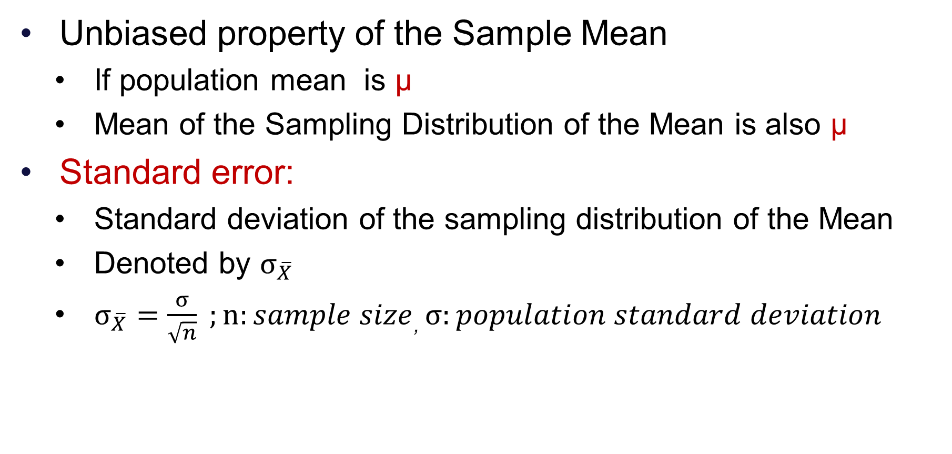
Sampling Distribution of the Mean
Unbiased property of the Sample Mean
If population mean is μ
Mean of the Sampling Distribution of the Mean is also μ
Standard error:
Standard deviation of the sampling distribution of the Mean
Denoted by $σ_{\overline{X}}$
$σ_{\overline{X}}=\frac{σ}{\sqrt{n}} ;n:sample size$, $σ:population standard deviation$

Slide 18
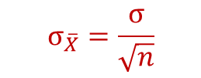
Sampling Distribution of the Mean
$\overline{X1}$, S1
X ~ N(µ,σ²)
$\overline{X}$ ~ N(µ,$σ_{\overline{X}}$²)
$$σ_{\overline{X}}=\frac{σ}{\sqrt{n}}$$
$\overline{X2}$, S2
X values
(Age, height, weight etc.)
$\overline{X}$ values
$\overline{Xm}$, Sm
Samples of size
n, with means $\overline{X1}$, $\overline{X2,}…\overline{Xm}$
Sampling Distribution of the Mean
Population: Random variable X

Slide 19
Sampling Distributions
Sampling Distributions
Sampling Distribution of the Mean
Sampling Distribution of the Proportion
Population: Normally Distributed
Population: Not Normally Distributed

Slide 20
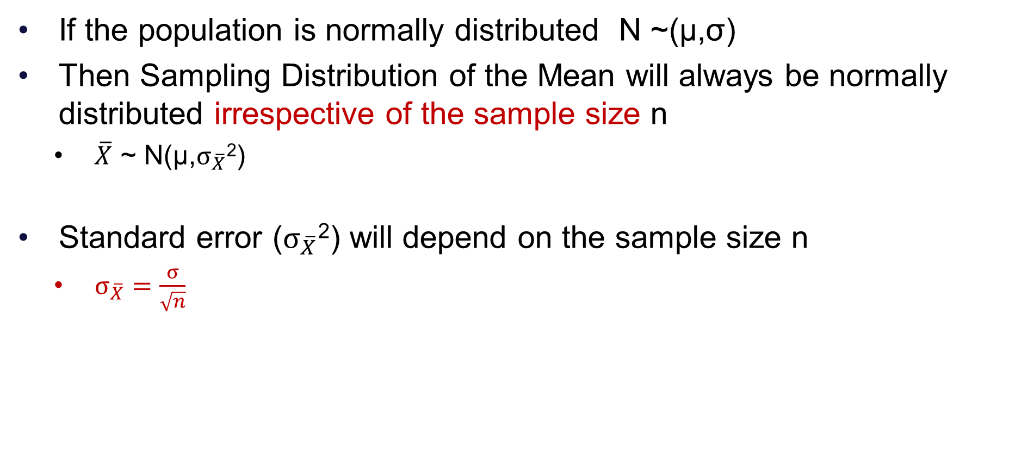
Sampling from a normally distribution population
If the population is normally distributed N ~(µ,σ)
Then Sampling Distribution of the Mean will always be normally distributed irrespective of the sample size n
$\overline{X}$ ~ N(µ,$σ_{\overline{X}}$²)
Standard error ($σ_{\overline{X}}$²) will depend on the sample size n
$σ_{\overline{X}}=\frac{σ}{\sqrt{n}}$

Slide 21
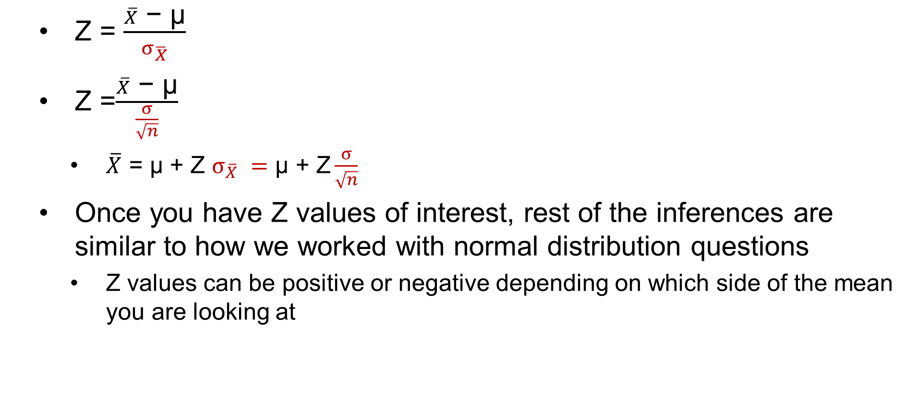
Z value for Sampling Distribution of the Mean
Z = $\frac{\overline{X} \text{−}\text{ µ}}{σ_{\overline{X}}}$
Z =$\frac{\overline{X}\text{ − µ}}{\frac{σ}{\sqrt{n}}}$
$\overline{X} \text{=}\text{ µ}$ + Z $σ_{\overline{X}} =\text{µ + }\text{Z}\frac{σ}{\sqrt{n}}$
Once you have Z values of interest, rest of the inferences are similar to how we worked with normal distribution questions
Z values can be positive or negative depending on which side of the mean you are looking at

Slide 22
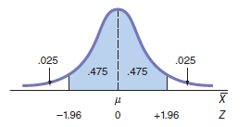
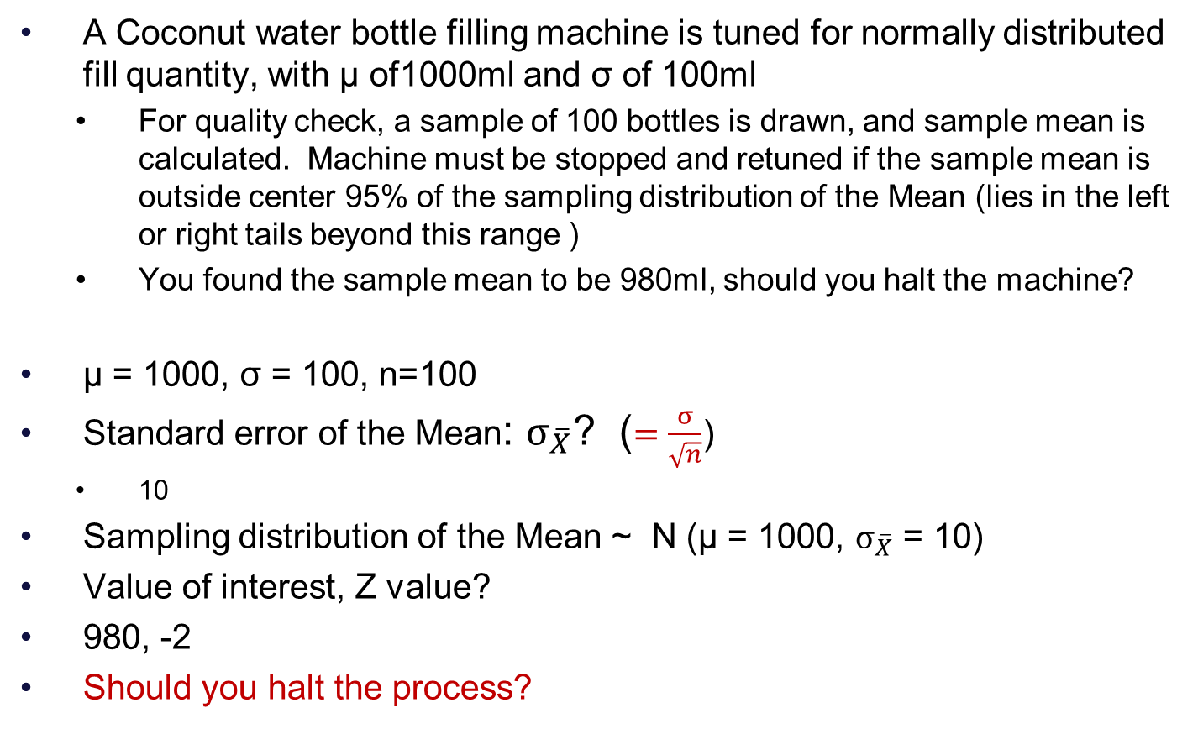
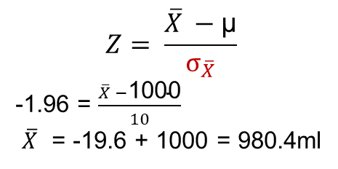
Example
A Coconut water bottle filling machine is tuned for normally distributed fill quantity, with µ of1000ml and σ of 100ml
For quality check, a sample of 100 bottles is drawn, and sample mean is calculated. Machine must be stopped and retuned if the sample mean is outside center 95% of the sampling distribution of the Mean (lies in the left or right tails beyond this range )
You found the sample mean to be 980ml, should you halt the machine?
µ = 1000, σ = 100, n=100
Standard error of the Mean: $σ_{\overline{X}}$? ($=\frac{σ}{\sqrt{n}}$)
10
Sampling distribution of the Mean ~ N (µ = 1000, $σ_{\overline{X}}$ = 10)
Value of interest, Z value?
980, -2
Should you halt the process?
Which cumulative probability entry will you see in the Z table?
.025 or .975
What is your lower halt cut-off in ml?
$$Z= \frac{\overline{X} −\text{µ}}{σ_{\overline{X}}}$$
-1.96 = $\frac{\overline{X} −\text{1000}}{10}$
$\overline{X}$ = -19.6 + 1000 = 980.4ml
What is the upper cut-off in ml?

Slide 23
Sampling Distributions
Sampling Distributions
Sampling Distribution of the Mean
Sampling Distribution of the Proportion
Population: Normally Distributed
Population: Not Normally Distributed

Slide 24
Sampling from a populations not normally distributed
The Central Limit Theorem
If the sample size is large enough (n>=30)
The Sampling Distribution of the Mean is approximately normally distributed
Regardless of the population distribution
Why are we interested in normality?
Thumb rule: for sample size of 30 or more, we consider the Sampling distribution of the Mean be normally distributed

Slide 25
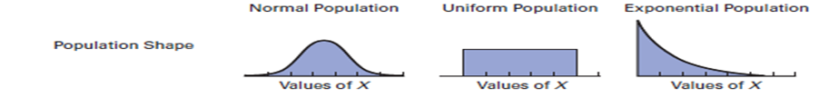
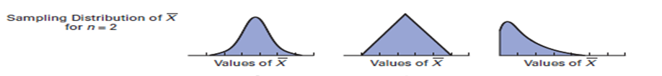
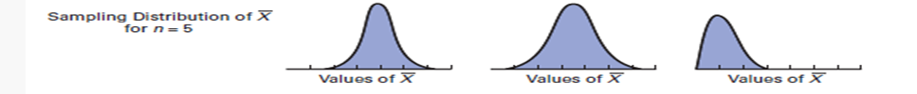
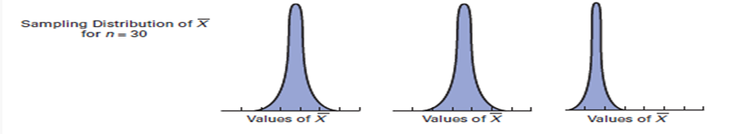
Central Limit Theorem: Empirical verification
Source: Levin et al. page: 256

Slide 26
Sampling Distributions
Sampling Distributions
Sampling Distribution of the Mean
Sampling Distribution of the Proportion
Population: Normally Distributed
Population: Not Normally Distributed

Slide 27
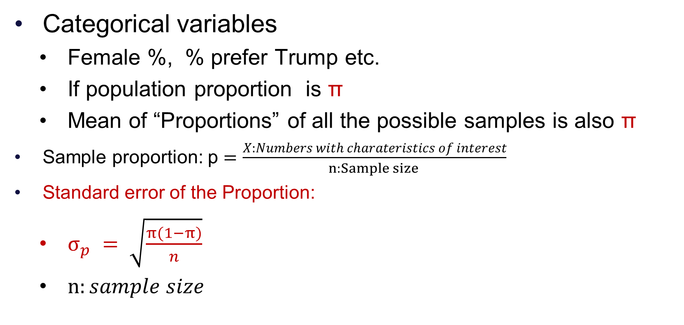
Sampling Distribution of the Proportion
Categorical variables
Female %, % prefer Trump etc.
If population proportion is π
Mean of “Proportions” of all the possible samples is also π
Sample proportion: p $=\frac{X:Numbers with charateristics of interest}{n:Sample size }$
Standard error of the Proportion:
$σ_{p} = \sqrt{\frac{π(1−π)}{n}}$
$n:sample size$

Slide 28
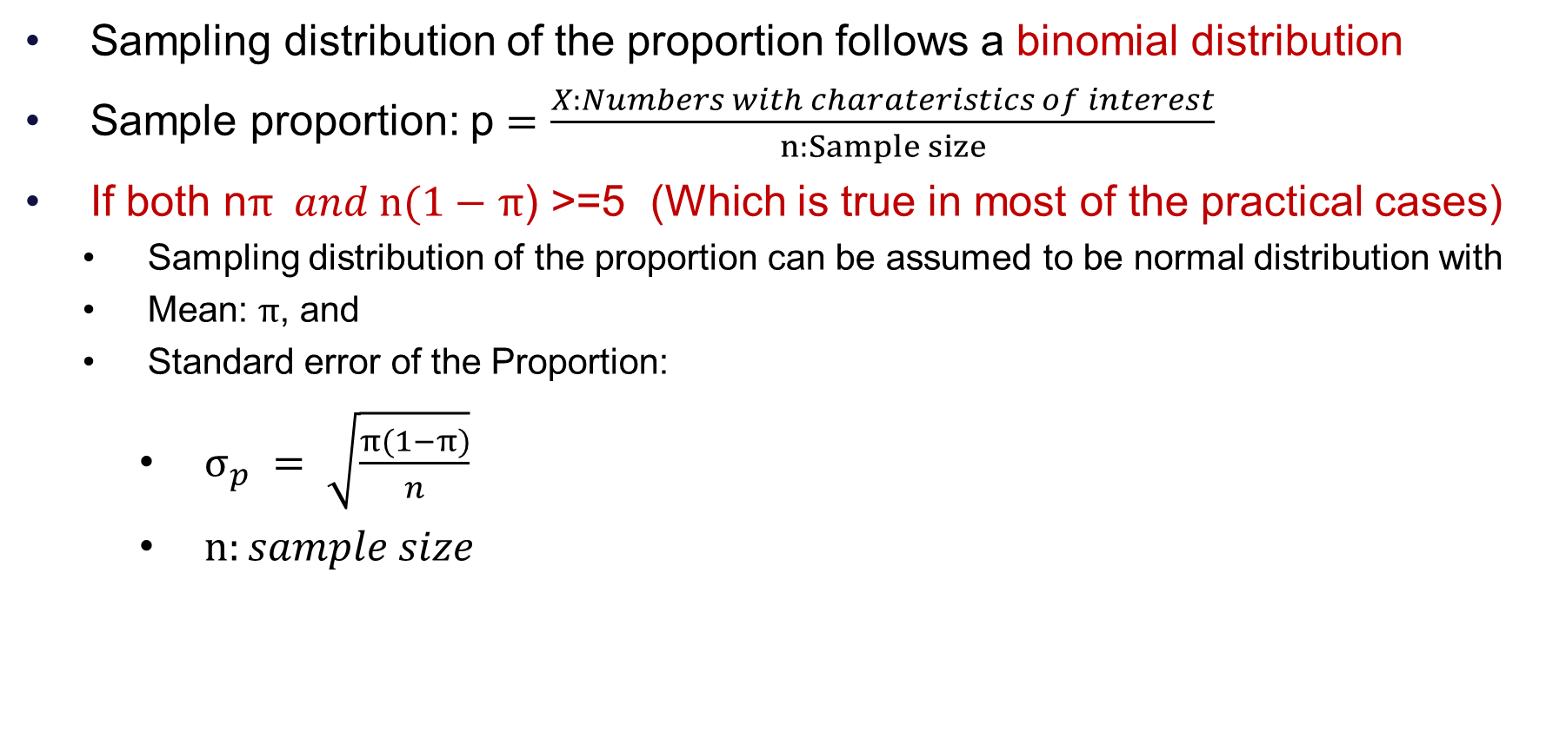
Sampling Distribution of the Proportion
Sampling distribution of the proportion follows a binomial distribution
Sample proportion: p $=\frac{X:Numbers with charateristics of interest}{n:Sample size}$
If both n$π and n(1−$ $π$) >=5 (Which is true in most of the practical cases)
Sampling distribution of the proportion can be assumed to be normal distribution with
Mean: $π$, and
Standard error of the Proportion:
$σ_{p} = \sqrt{\frac{π(1−π)}{n}}$
$n:sample size$

Slide 29
Sampling Distribution of the Proportion
p1
Mean $= π$
$$σ_{P}=\sqrt{\frac{π(1−π)}{n}}$$
Population proportion: $π$
Size: N
p2
Proportion females, supporting candidate-A, products containing faults etc.
pm
$$p$$
Samples of size n,
with proportions p1, p2, …, pm
Assuming: n$π$ and n(1- $π$)>=5
Sampling Distribution of the Proportion
Random Variable: $p$

Slide 30
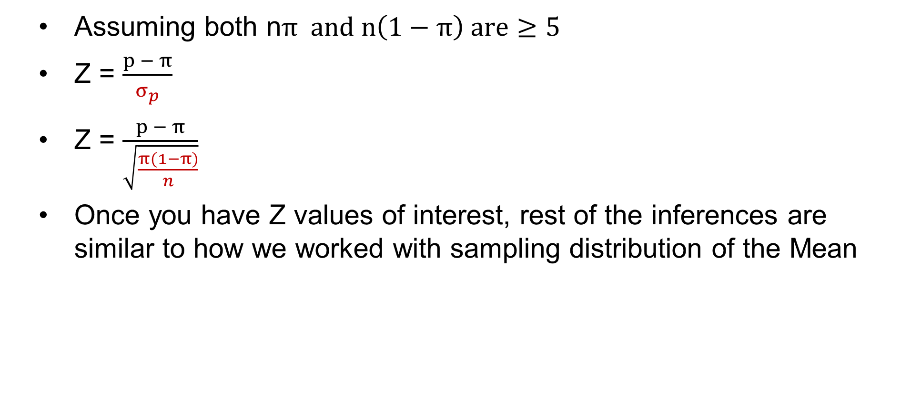
Z value for Sampling Distribution of the Proportion
Assuming both n$π and n\left(1−π\right) are≥5$
Z = $\frac{p − π}{σ_{p}}$
Z = $\frac{p − π}{\sqrt{\frac{π(1−π)}{n}}}$
Once you have Z values of interest, rest of the inferences are similar to how we worked with sampling distribution of the Mean

Slide 31
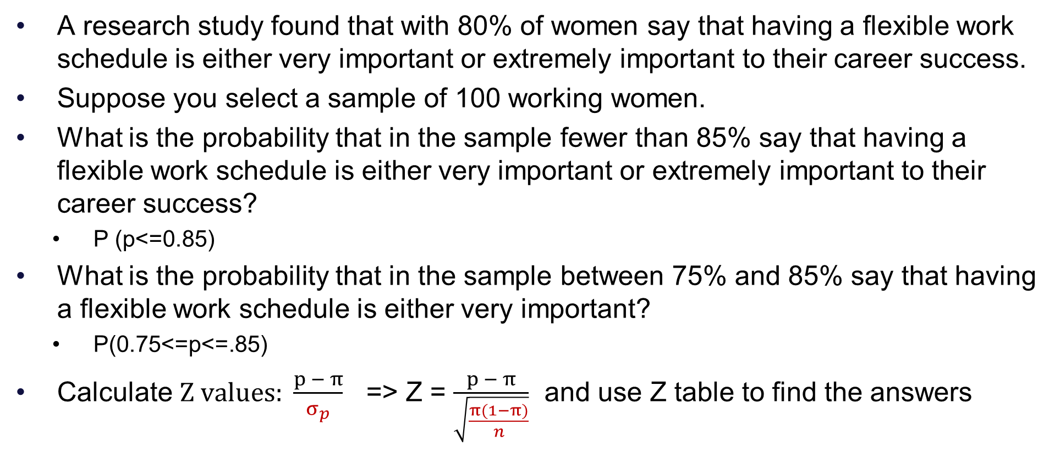
A question from the book (7.14 p 262)
A research study found that with 80% of women say that having a flexible work schedule is either very important or extremely important to their career success.
Suppose you select a sample of 100 working women.
What is the probability that in the sample fewer than 85% say that having a flexible work schedule is either very important or extremely important to their career success?
P (p<=0.85)
What is the probability that in the sample between 75% and 85% say that having a flexible work schedule is either very important?
P(0.75<=p<=.85)
Calculate $Z values: \frac{p − π}{σ_{p}}$ => Z = $\frac{p − π}{\sqrt{\frac{π(1−π)}{n}}}$ and use Z table to find the answers

Slide 32
Exam related questions
Syllabus
Descriptive Statistics, Statistical charts, measures of central tendency and dispersion
Data scales, Probability, Bayes Theorem
Probability distributions
Including discrete distributions and continuous distributions, and the mean and variance of a probability distribution.
Up-to session-7 (Normal distribution)
Calculator is allowed
Onscreen version or your own
One sided Z cumulative probability table will be provided
You can type your answers or upload handwritten answers after scanning
All the best!

Slide 33
Q&A

